Slide 1

BDM300 Final Project
Tuan Kiet Nguyen
Notes:
Hello everyone, my name is Tuan Nguyen. Today, I’m going to present my analysis on COVID-19 to identify patterns and predict trends.

Slide 2
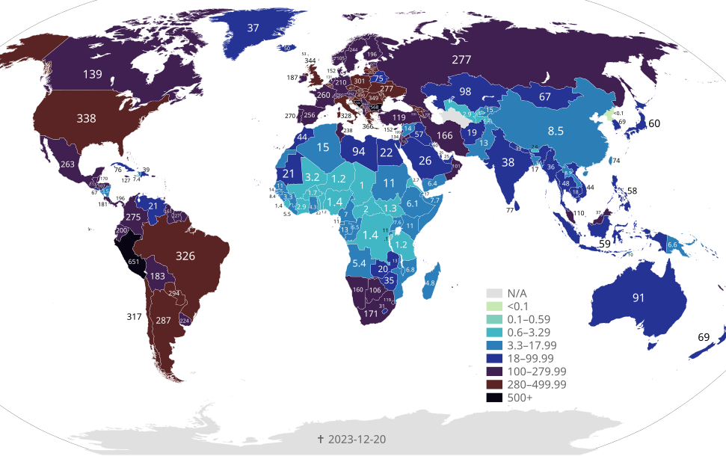
Dataset Description
overview
The dataset provides a comprehensive overview of COVID-19 statistics from various countries.
Link: https://www.kaggle.com/datasets/imdevskp/corona-virus-report
Notes:
I'll be using a dataset sourced from Kaggle, then read the slide

Slide 3
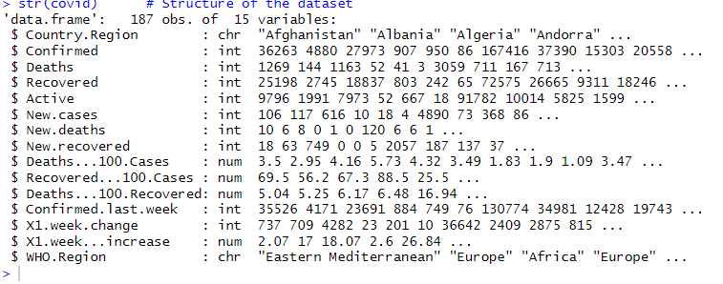
Dataset Description
Country.Region: Country name.
WHO.Region: WHO region classification (e.g., Europe, Americas).
Confirmed: Total confirmed cases.
Deaths: Total deaths reported.
Recovered: Total recovered cases.
Active: Active cases.
New.cases: Newly reported cases.
New.deaths: Newly reported deaths.
New.recovered: Newly reported recoveries.
Confirmed.last.week: Confirmed cases in the last week.
X1.week.change: Change in cases in one week (percentage).
X1.week...increase: Weekly increase in confirmed cases.
Notes:
It includes these attributes like (read the slide)

Slide 4

Business Problem

Slide 5
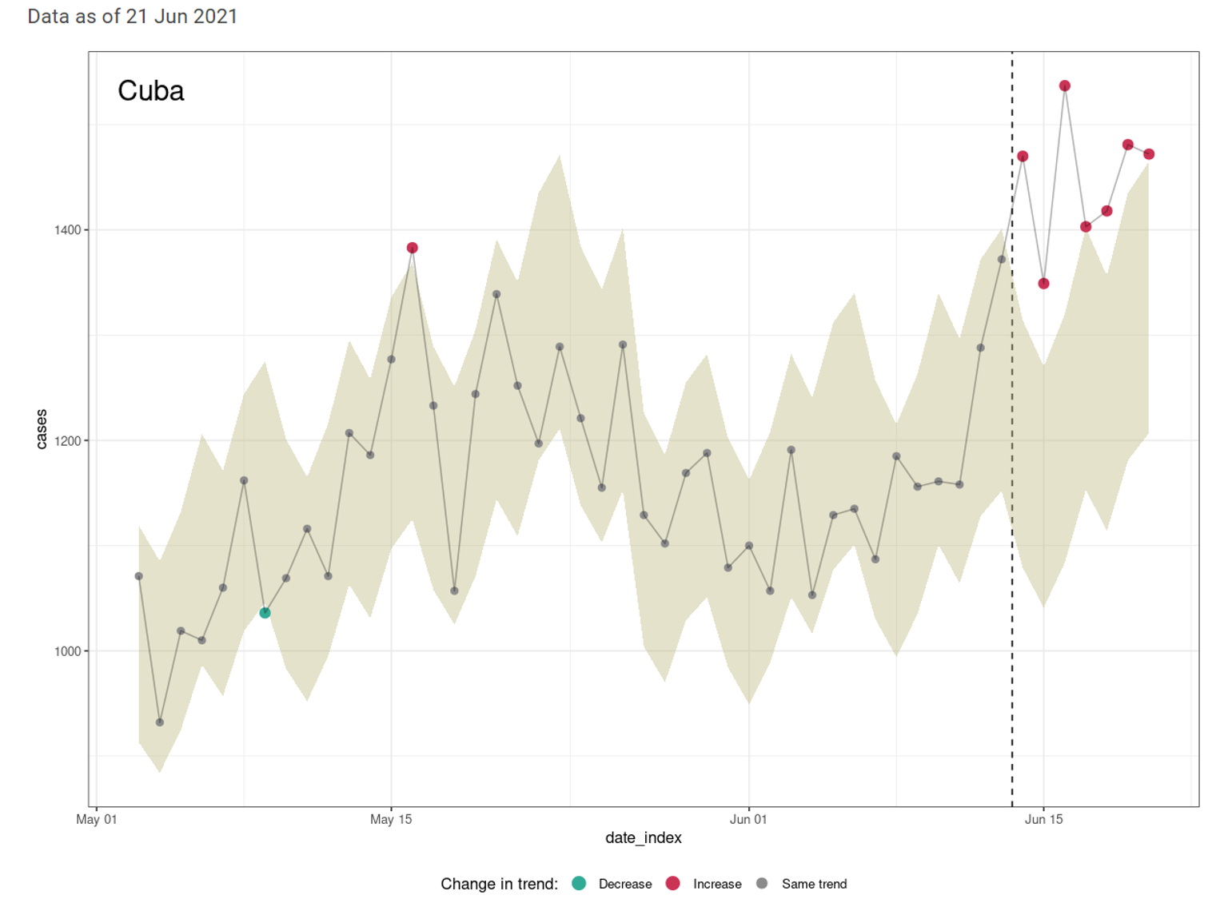
Business Problem
The primary goal of this analysis is to predict the number of confirmed COVID-19 cases in various regions, such as countries or WHO regions, using independent variables such as the number of deaths, recoveries, active cases, and other relevant factors.
By leveraging variables like deaths, recoveries, and active cases, the model aims to uncover patterns and relationships that influence the spread and confirmation of cases.

Slide 6

Business Problem
This predictive approach serves several key purposes:
- Public health officials, governments, and organization can use predictions to anticipate the demand for critical resources such as hospital beds, intensive care units (ICUs), ventilators, medical supplies, and healthcare personnel.
- Predictive models can provide a clearer understanding of the pandemic’s trend, helping to monitor its progression across different regions.

Slide 7

Data Extraction and Loading

Slide 8
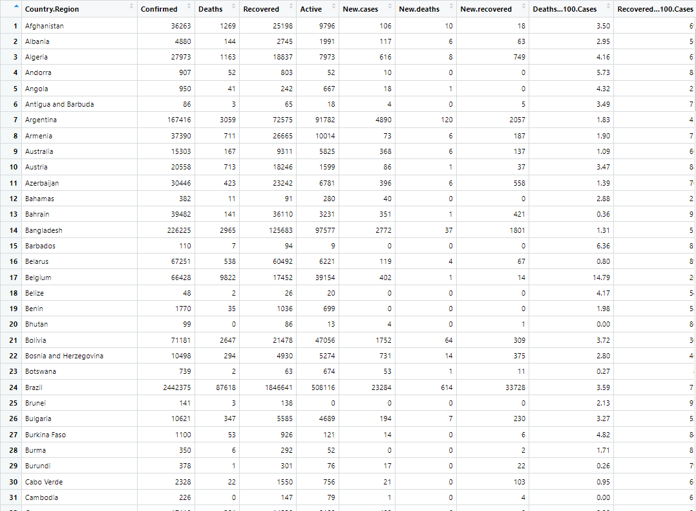
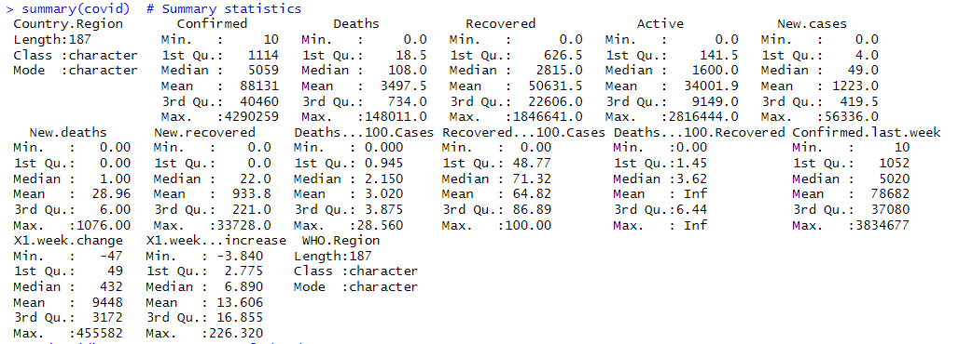
# Load necessary libraries
library(ggplot2)
library(readr) # For loading CSV files
library(corrplot) # For visualizing correlations
library(dplyr)
library(class)
covid <- read.csv("./country_wise_latest.csv“)
summary(covid) #Summarystatistics
str(covid) # Structure of the dataset
head(covid) # First 6 rows of the data
tail(covid) # Last 6 rows of the data

Slide 9
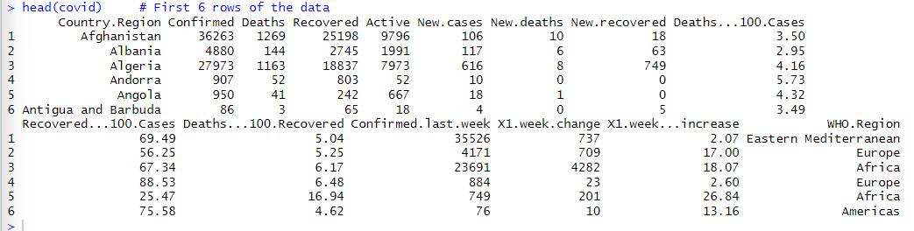
# Load necessary libraries
library(ggplot2)
library(readr) # For loading CSV files
library(corrplot) # For visualizing correlations
library(dplyr)
library(class)
covid <- read.csv("./country_wise_latest.csv“)
summary(covid) #Summarystatistics
str(covid) # Structure of the dataset
head(covid) # First 6 rows of the data
tail(covid) # Last 6 rows of the data

Slide 10

Data Preprocessing

Slide 11
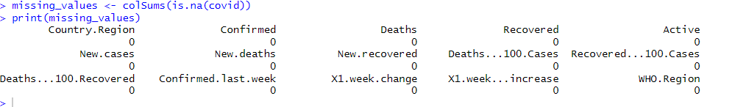
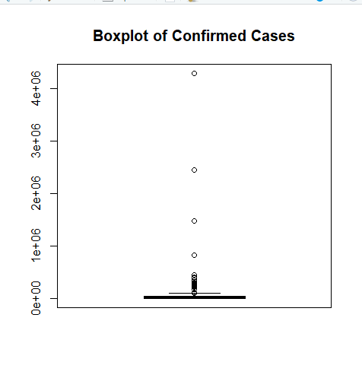
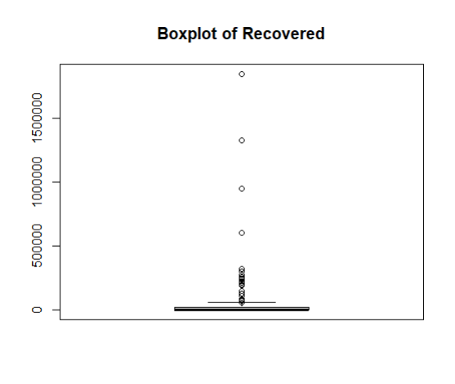
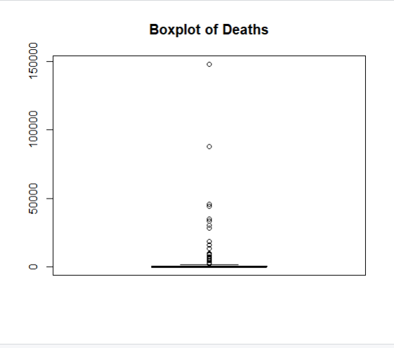
missing_values <- colSums(is.na(covid))
print(missing_values)
# Remove rows with missing values (if necessary)
covid <- na.omit(covid)
# Convert columns to appropriate data types
covid$Country.Region <- as.factor(covid$Country.Region)
covid$WHO.Region <- as.factor(covid$WHO.Region)
boxplot(covid$Confirmed, main = "Boxplot of Confirmed Cases")
boxplot(covid$Deaths, main = "Boxplot of Deaths")
boxplot(covid$Recovered, main = "Boxplot of Recovered")

Slide 12
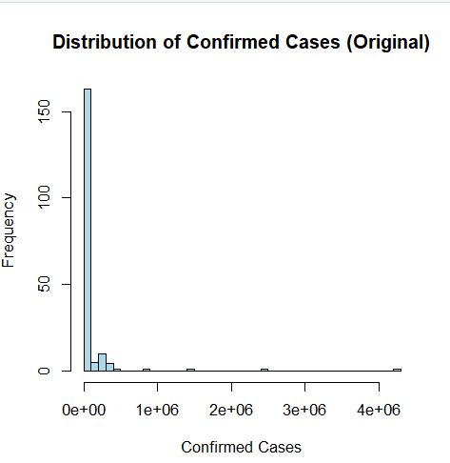
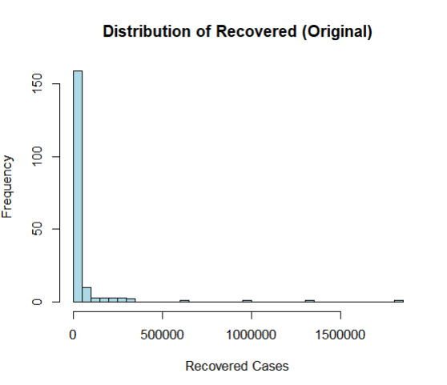
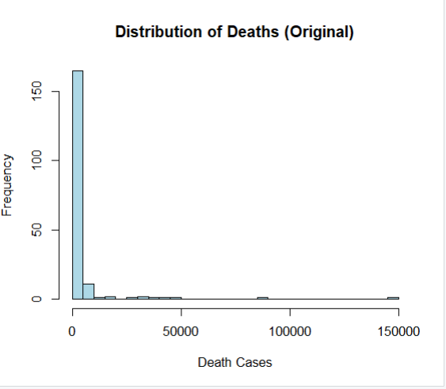
hist(covid$Confirmed, main = "Distribution of Confirmed Cases (Original)", xlab = "Confirmed Cases", col = "lightblue", breaks = 50)
hist(covid$Deaths, main = "Distribution of Deaths (Original)", xlab = "Death Cases", col = "lightblue", breaks = 50)
hist(covid$Recovered, main = "Distribution of Recovered (Original)", xlab = "Recovered Cases", col = "lightblue", breaks = 50)

Slide 13
Outlier Detection and Removal
The histogram of the 'Confirmed', ‘Deaths’, and ‘Recovered’ column are right-skewed and their box plots also indicate significant outliers. This is common in real-life datasets, especially with global events like the COVID-19 pandemic, where most countries have few confirmed cases, but some have exceptionally high numbers. These extreme values can affect analysis and predictions.
To improve accuracy, we remove the outliers from 3 main numerical columns. This helps in modeling the data more effectively and drawing reliable conclusions about the distribution of confirmed cases across regions.
# Outlier Detection and Removal using IQR method for specified columns
columns <- c("Confirmed", "Deaths", "Recovered")
# Loop through them and remove outliers
for (col in columns) {
# Calculate IQR
Q1 <- quantile(covid[[col]], 0.25, na.rm = TRUE)
Q3 <- quantile(covid[[col]], 0.75, na.rm = TRUE)
IQR <- Q3 - Q1
# Define the bounds for outliers
lower <- Q1 - 1.5 * IQR
upper <- Q3 + 1.5 * IQR
# Filter the dataset to remove outliers
covid <- covid %>% filter(covid[[col]] >= lower & covid[[col]] <= upper)
}

Slide 14
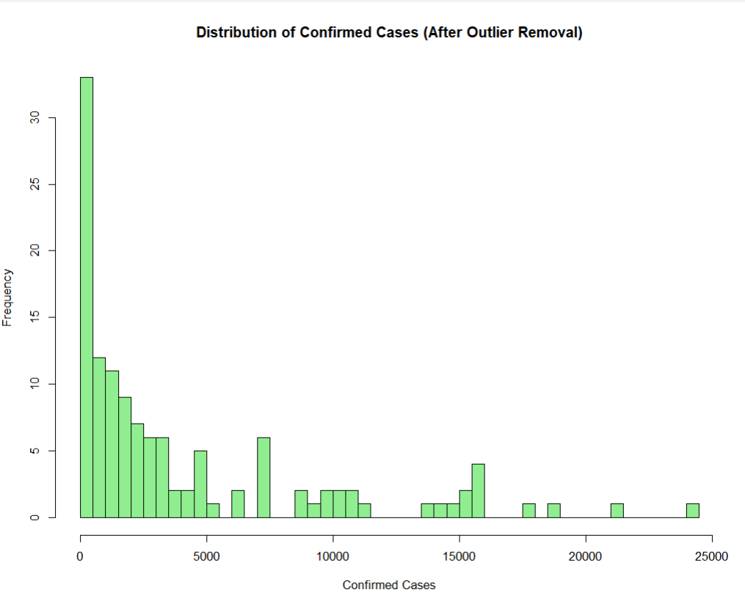
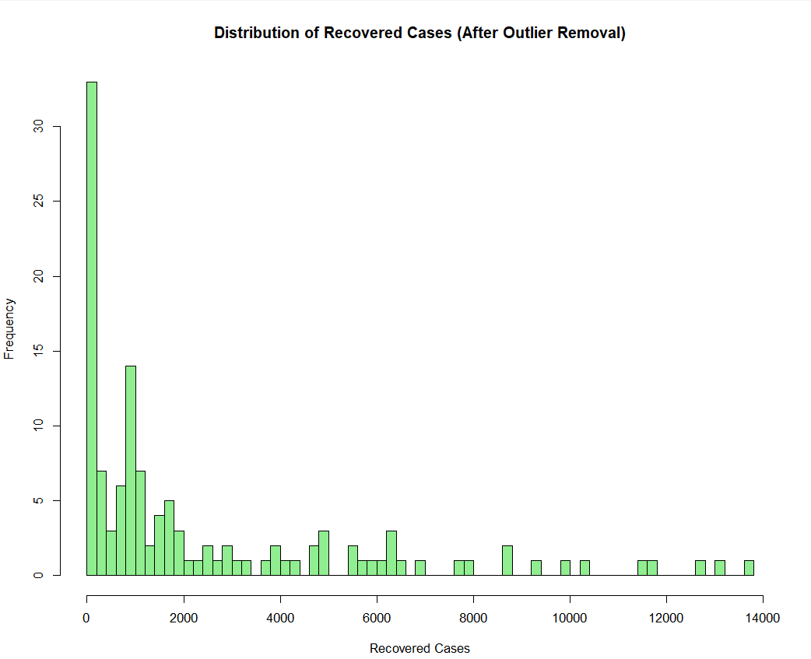
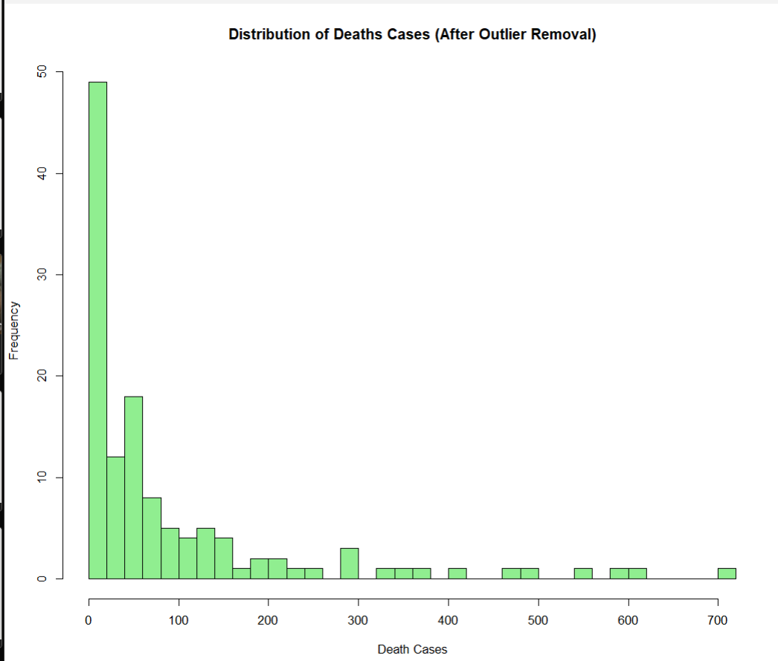
hist(covid$Confirmed, main = "Distribution of Confirmed Cases (After Outlier Removal)", xlab = "Confirmed Cases", col = "lightgreen", breaks = 50)
hist(covid$Deaths, main = "Distribution of Deaths Cases (After Outlier Removal)", xlab = "Confirmed Cases", col = "lightgreen", breaks = 50)
hist(covid$Recovered, main = "Distribution of Confirmed Cases (After Outlier Removal)", xlab = "Confirmed Cases", col = "lightgreen", breaks = 50)
After removing the outliers, the data of these columns are now more evenly distributed. While they remain right-skewed, this is expected, as the distribution still reflects the natural variance seen in real-world datasets, particularly for global phenomena like the COVID-19 pandemic.

Slide 15
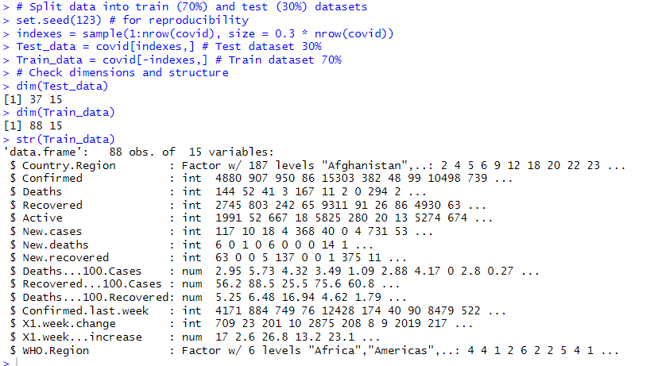
Split Data into Train and Test Datasets
set.seed(123) # for reproducibility
indexes = sample(1:nrow(covid), size = 0.3 * nrow(covid))
Test_data = covid[indexes,] # Test dataset 30%
Train_data = covid[-indexes,] # Train dataset 70%
dim(Test_data)
dim(Train_data)
str(Train_data)

Slide 16

Graph Analysis

Slide 17
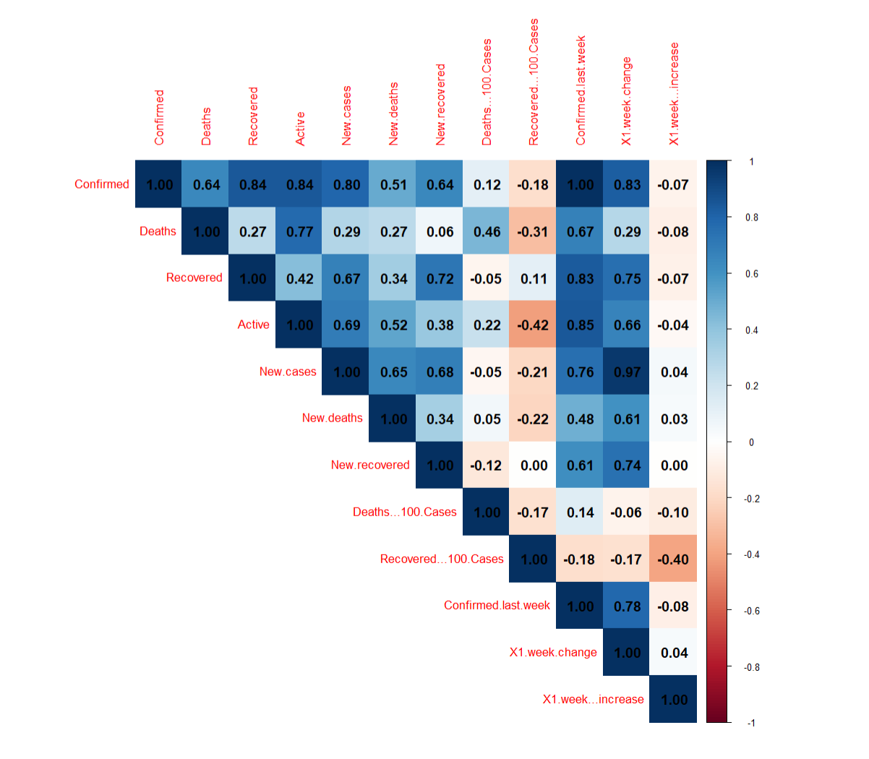
Correlation between Numeric Columns
# Calculate correlation between numeric columns
numeric_columns <- names(covid)[sapply(covid, is.numeric)]
Attribute_Corr <- cor(Train_data[, numeric_columns], method = "pearson")
# Plot Correlation heatmap
library(corrplot)
corrplot(Attribute_Corr, type = "upper", method = "color", addCoef.col = "black", title = "Correlation between the attributes", number.cex = 14 / ncol(Train_data[, numeric_columns]), mar = c(1, 1, 1, 1))
From the correlation heatmap, we can see that attribute like Recovered, Active, New.cases, Deaths showed the strongest positive correlations with Confirmed.

Slide 18
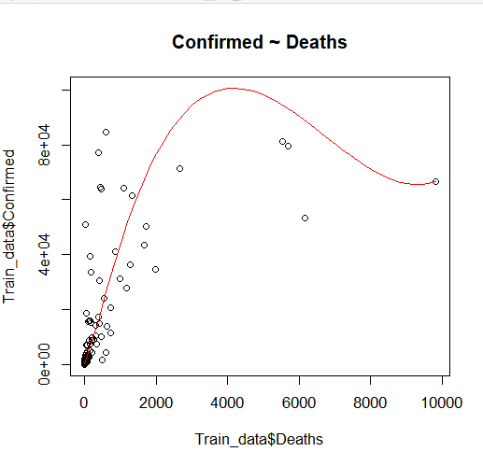
‘Confirmed’ column’s relationship with other independent variables
#Numerical Variables:
#Deaths
scatter.smooth(x = Train_data$Deaths, y = Train_data$Confirmed, lpars = list(col = "red", lwd = 1, lty = 1), main = "Confirmed ~ Deaths")
As the number of confirmed cases increase, there is a rise in the number of deaths, indicating a good correlation between the two variables. However, at higher levels of confirmed cases, the trend appears to shift slightly downward, with a decline in deaths. This could suggest the influence of other factors, such as improved medical interventions, better management of severe cases, or variations in data at higher case counts."

Slide 19
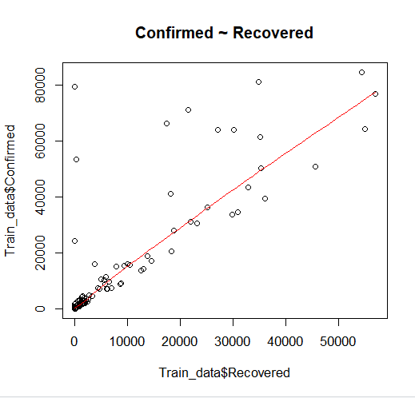
‘Confirmed’ column’s relationship with other independent variables
#Numerical Variables:
#Recovered
scatter.smooth(x = Train_data$Recovered, y = Train_data$Confirmed, lpars = list(col = "red", lwd = 1, lty = 1), main = "Confirmed ~ Recovered")
The recovered cases also increase as confirmed cases rise in a linear relationship. This pattern highlights a positive outcome, suggesting that as the number of case grows, a proportionate number of individuals are also successfully recovering, potentially reflecting the effectiveness of healthcare treatments.

Slide 20
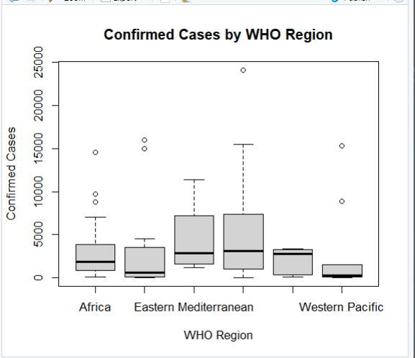
‘Confirmed’ column’s relationship with other independent variables
#Categorical Variables:
#WHO.Region
boxplot(Confirmed ~ WHO.Region, data = Train_data, main = "Confirmed Cases by WHO Region", xlab = "WHO Region", ylab = "Confirmed Cases")

Slide 21
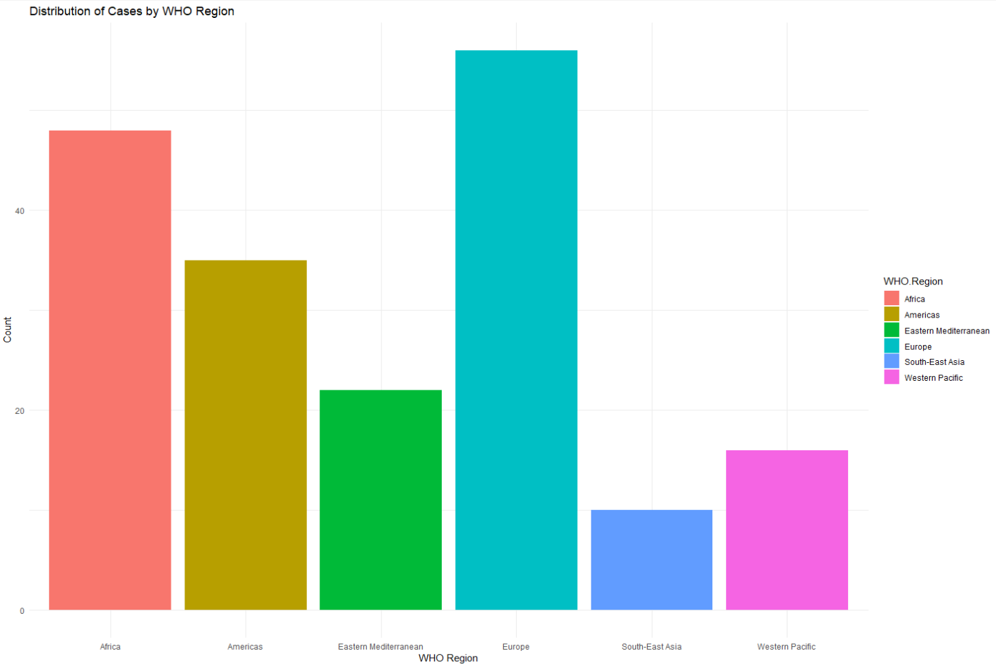
‘Confirmed’ column’s relationship with other independent variables
#Categorical Variables:
#WHO.Region
ggplot(covid, aes(x = WHO.Region, fill = WHO.Region)) +
geom_bar() +
labs(title = "Distribution of Cases by WHO Region", x = "WHO Region", y = "Count") +
theme_minimal()

Slide 22

Data Mining

Slide 23
Overview
A regression model was developed using the training dataset to predict confirmed cases:
Approach: Linear regression on the log-transformed Confirmed cases.
Independent Variables: all the numerical columns in the dataset.
# Create the regression model (before outlier removals)
covid_model <- lm(log(Confirmed) ~ Deaths + Recovered + Active + Deaths...100.Cases + Recovered...100.Cases + Confirmed.last.week, data = Train_data)
# View summary of the model
summary(covid_model)
# Predict on the Test dataset
pred_covid <- predict(covid_model, Test_data) # Summary of prediction summary(pred_covid)

Slide 24
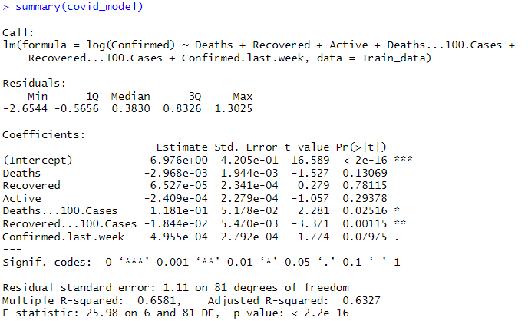
Key Findings
Key findings:
Model Performance: The model has a reasonable R-squared value of 0.6581, which means it explains about 66% of the variance in the log(Confirmed) cases. The residual standard error of 1.11 indicates a moderate level of prediction error.
Significance of Predictors: Variables like Deaths...100.Cases and Recovered...100.Cases are statistically significant, while others like Deaths, Recovered, and Active do not have a significant impact on the model’s predictions.

Slide 25
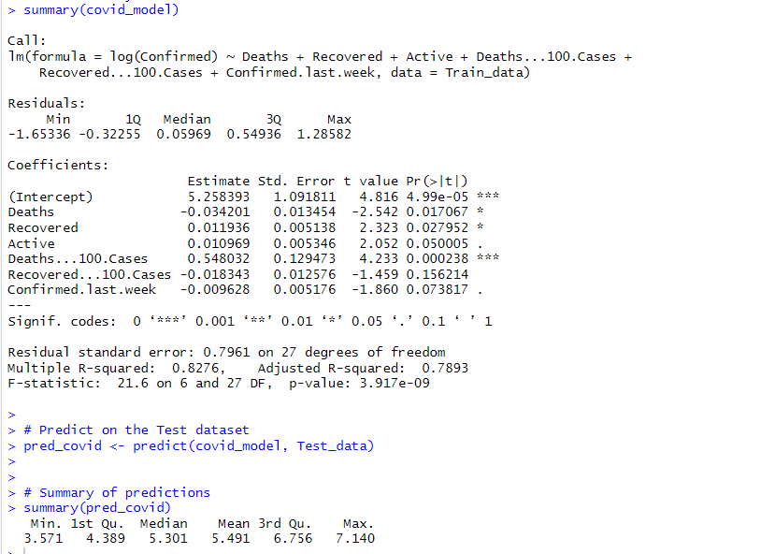
How to Improve the Model’s Accuracy?
- Follow the mentioned steps and remove outliers from the necessary columns.
Key findings:
The updated model (covid_model) shows improvements in fit and predictor significance compared to the previous one:
Model Summary:
Significant Predictors:
Deaths, Recovered, and Deaths...100.Cases are significant predictors.
Active is borderline significant, while Recovered...100.Cases and Confirmed.last.week are not significant.

Slide 26
How to Improve the Model’s Accuracy?
Model Fit:
Multiple R-squared: 0.8276, indicating the model explains 82.76% of the variance, an improvement over the previous model.
Residual Standard Error: 0.7961, lower than before, suggesting more accurate predictions.
F-statistic: 21.6 with a very small p-value, showing the model is highly significant.
Prediction Summary:
The predicted log-transformed confirmed cases range from 3.57 to 7.14, with a mean of 5.49, showing a more consistent prediction pattern compared to the previous model.
Conclusion:
The model shows improved accuracy and fit, with key predictors now significant. The predictions are more consistent, and the residual error has decreased.

Slide 27

Conclusion
In summary, this predictive analysis serves as a vital tool to forecast the spread of COVID-19 and its impact. By utilizing variables such as deaths, recoveries, and active cases, we can better understand the pandemic’s trends and provide insights for resource allocation and crisis management. This approach not only supports public health officials and governments but also contributes to a more informed global response to future health crises.

Slide 28

Thank you for listening

